Slide 1
Applied Predictive Analytics and Machine Learning in predicting stock outcome.
Author: Phong Nguyen
MSDS692

Slide 2
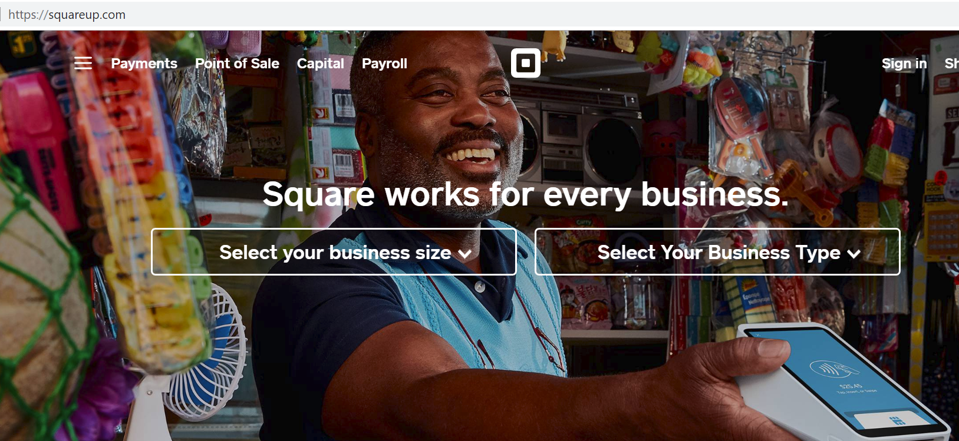
Project Overview
Predict SQ stock price
SQ was published IPO in November 19, 2015.
SQ is a financial payment service and Point-of-Sale business.
The dataset is downloaded from:
https://finance.yahoo.com/quote/SQ/history?p=SQ

Slide 3

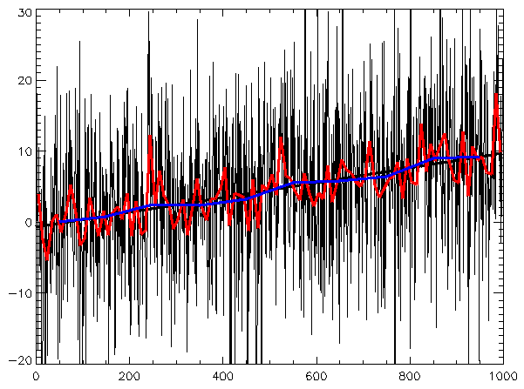

Methods
Predictive Analytics is applied to analyze the stock SQ stock and predict.
Regression and Time Series are two Predictive Analytics methods to predict.
Applied Machine Learning to reinforced the results from Linear regression.

Slide 4
ML Linear Regression
F-statistic
Train data
Test data
Build the model and run the model
Check the correlations between variables
If F-Statistics > 1,which is the correlation is good
If R^2 is closer to 1, the model good fit.
In this model, F-statistics = 285 and R^2 = 0.9295
Model is good so far.

Slide 5
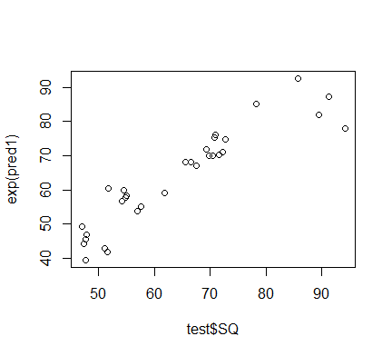
Linear Regression graph
Linear Regression generated the outcome.
Maximum price is around 95 dollar
Linear Regression isn’t enough
Detail information about the future price.

Slide 6
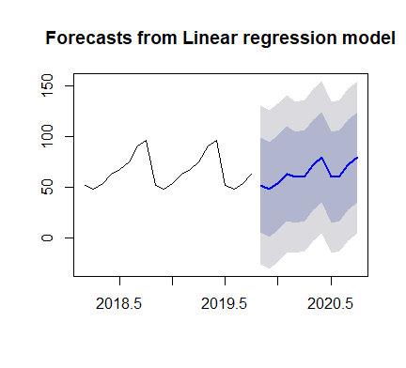
Linear Regression for Time Series
ML Linear Regression is providing the overview SQ stock price
ML Linear regression doesn’t provide the detain and the short term, medium term and long term SQ stock price
Time Series Regression provides at detail level information.
Time Series Regression provides the short term, medium term and long term SQ stock price.

Slide 7
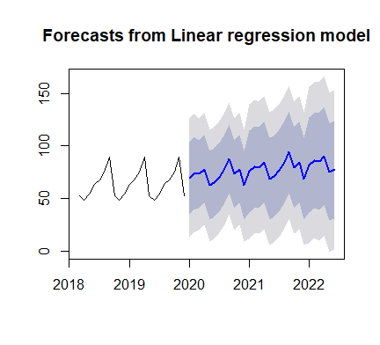
Compared two methods
There aren’t a big different in two methods.
ML Linear regression is general predictions
Time Series Regression provides detail level from time to time. Time Series Regression could project the SQ price in the near future .
It’s good information to the investors.

Slide 8
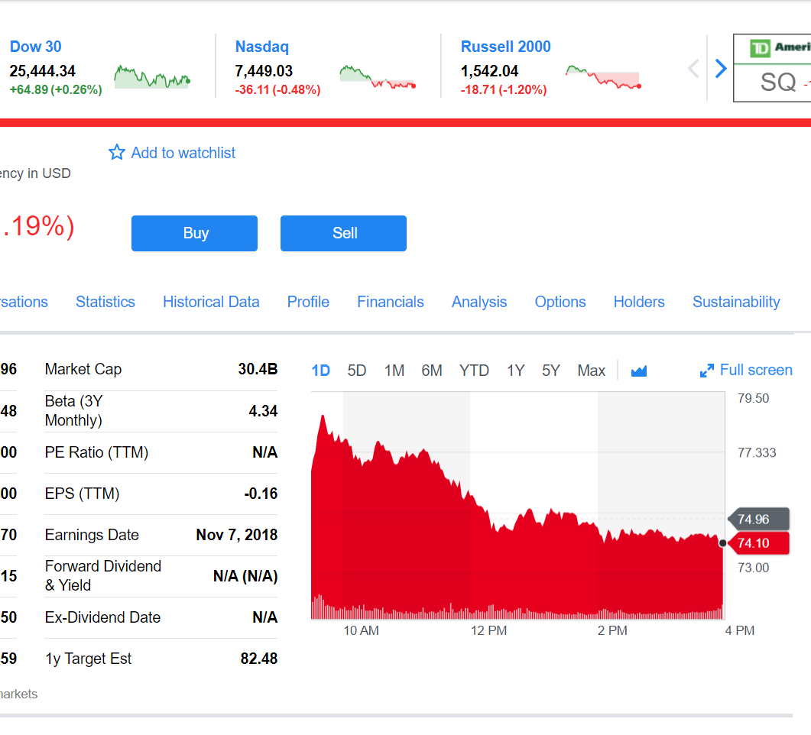
Conclusions
Which method is better fit ?
It depends on the users.
SQ stock price at the end of trading week. It’s up to dated information.

Slide 9
Questions and Answers:
Any questions, please email: pnguyen14@regis.edu
Thank you very much for your time.

